Slide 1

Technical University of Denmark
42002 Modelling and Analysis of Sustainable Energy Systems
Using Operations Research
Final Project
Sigurd Indrehus s193028
Lorenzo Mininni s192445
Jorge Montalvo Arvizu s192184
Ajinkya Pradip Mahale s192206
Fall 2019

Slide 2
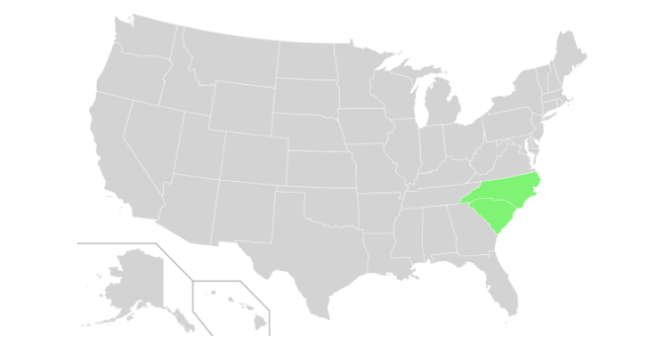
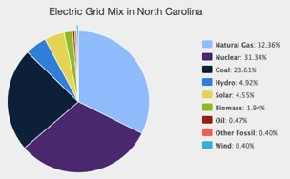
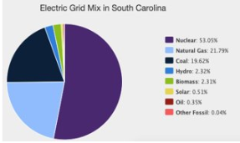
Base Scenario in 2021
Region: North and South Carolina, USA
Electricity mix dominated by Natural Gas, Coal and Nuclear
Low renewable share, huge potential for solar and wind
Goal for 2021: 12.5% generation from renewables

Slide 3
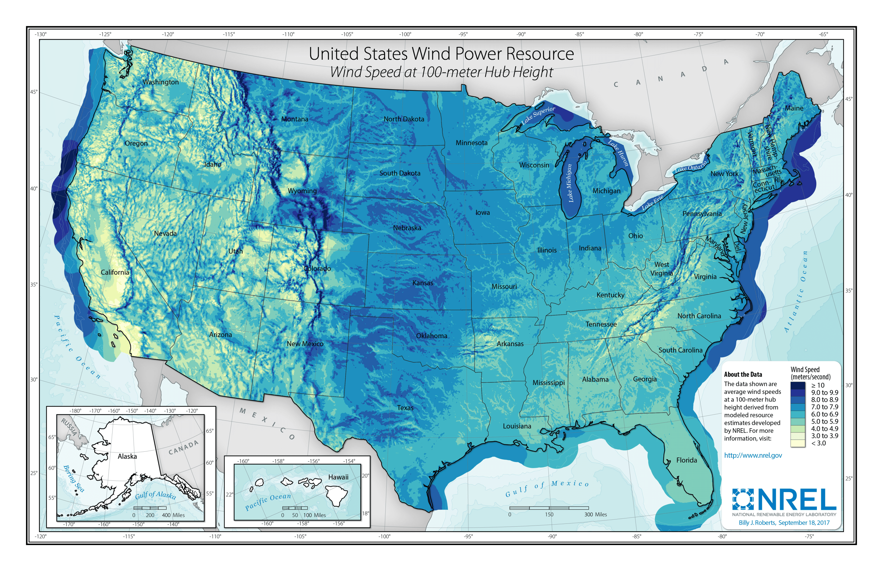
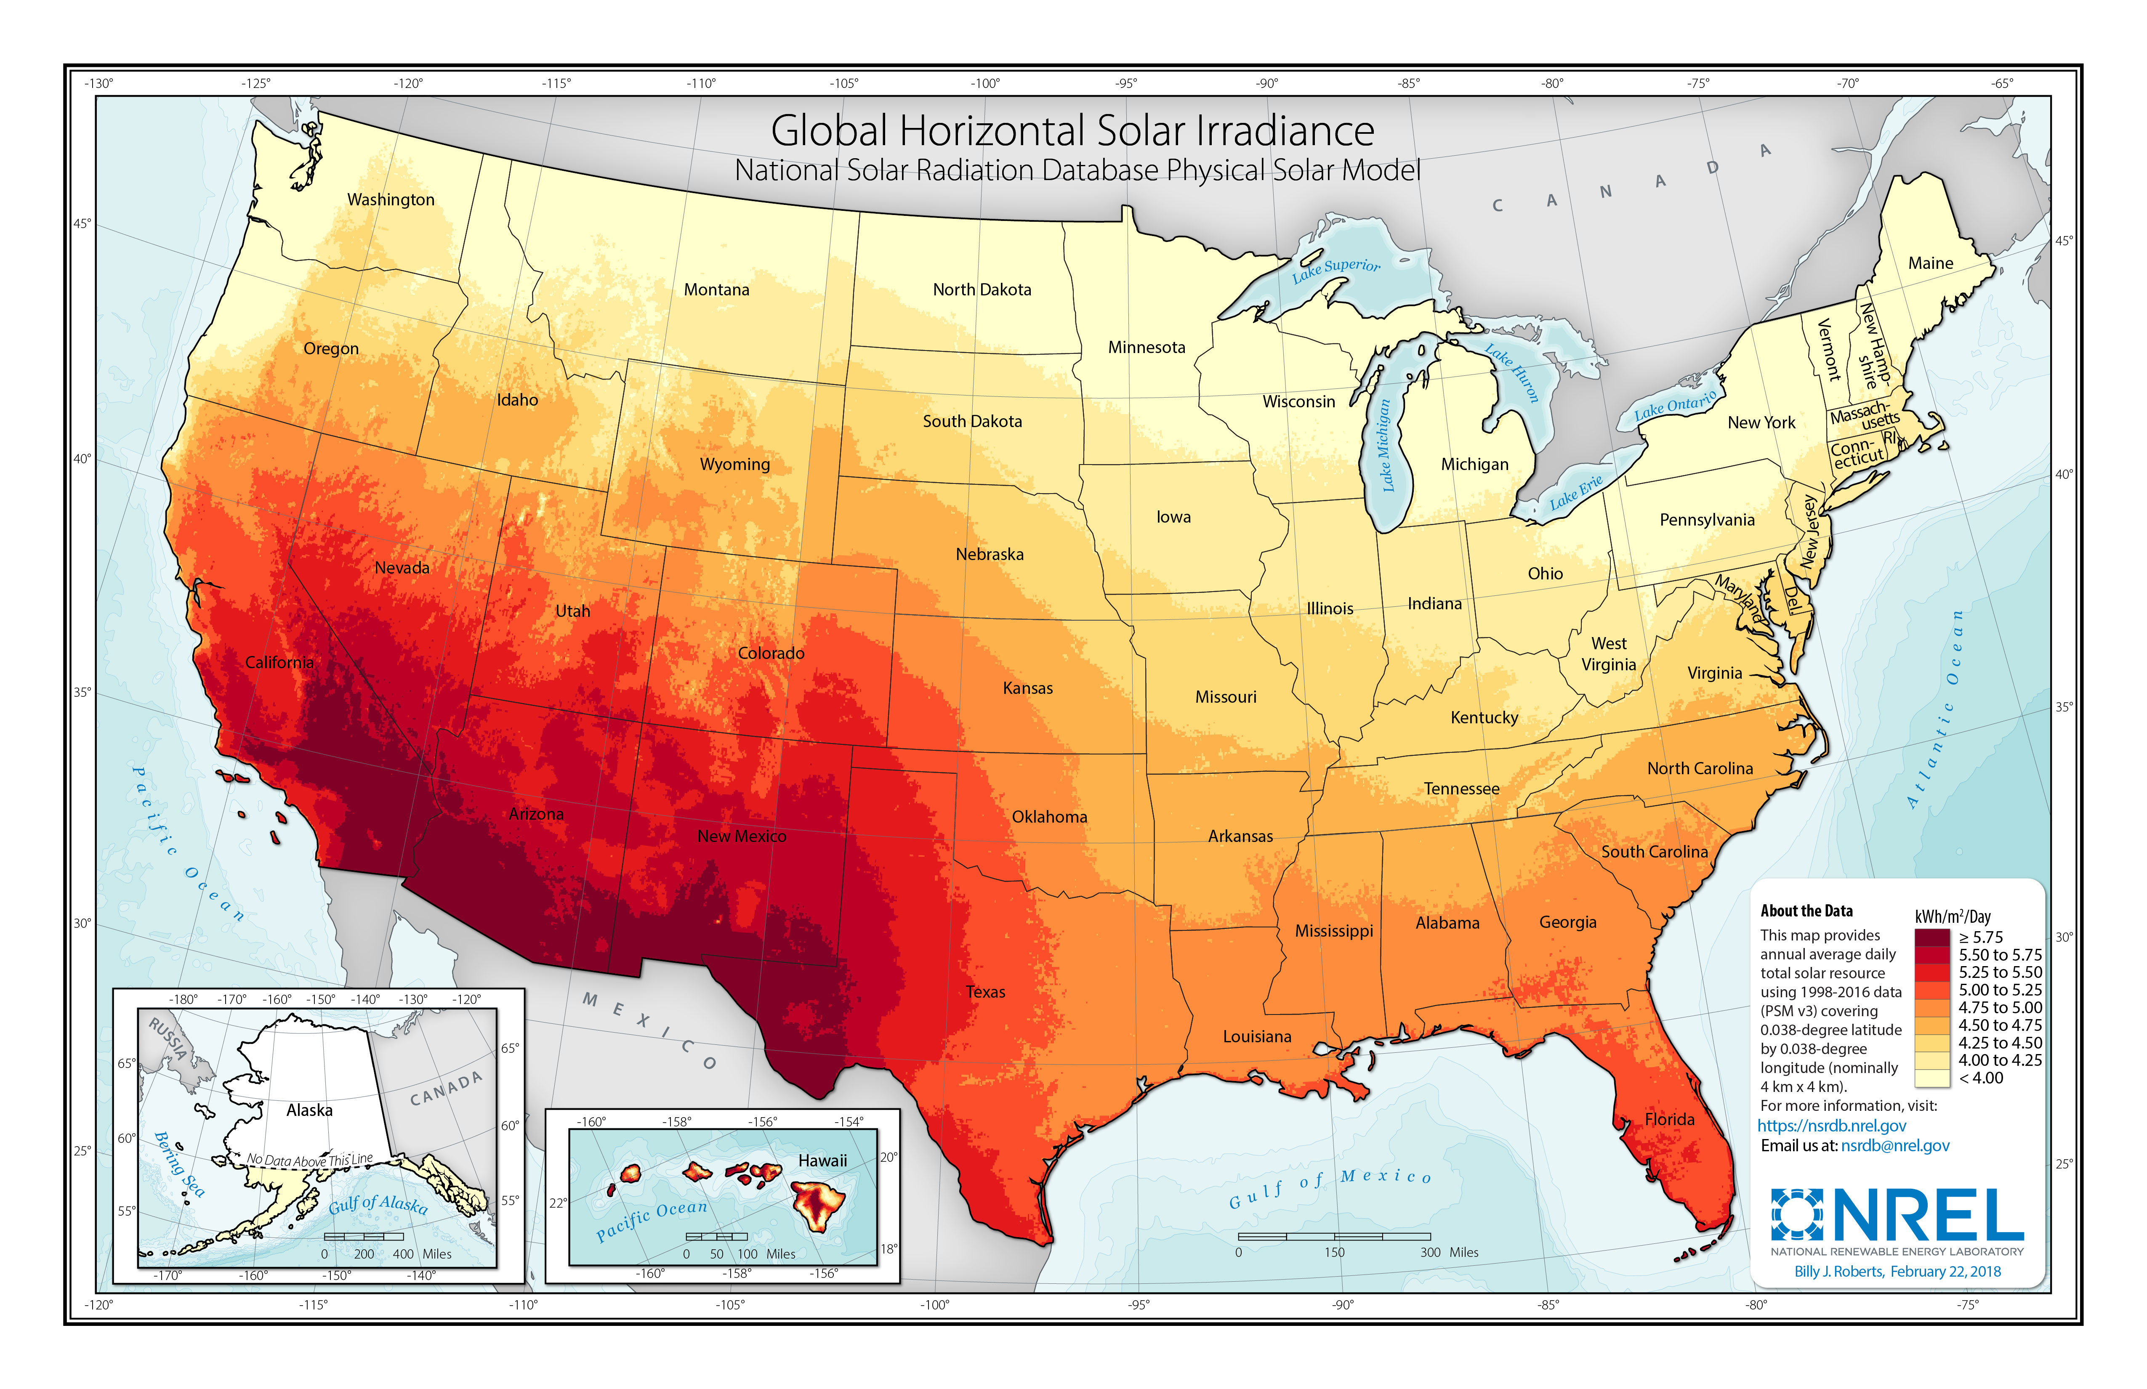
Wind & Solar
Renewables.ninja
Nrel.gov

Slide 4
Implementations
Non-renewables
- Coal
- Natural Gas
- Diesel
- Nuclear
Renewables
- Wind
- Solar
- Hydro

Slide 5
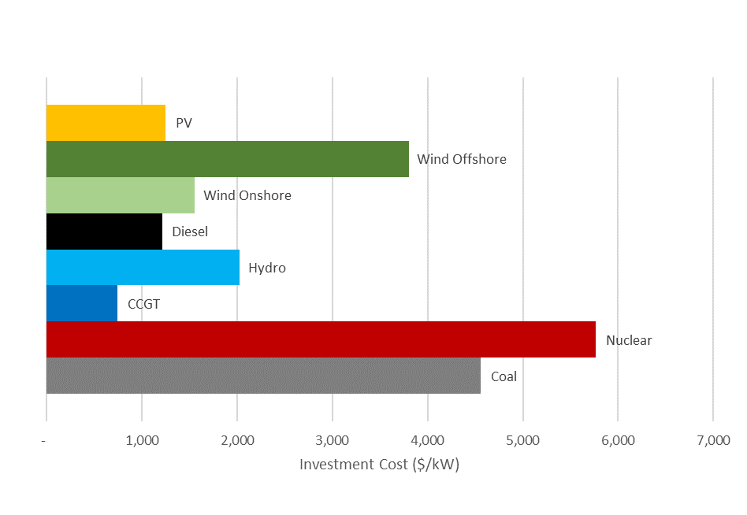
Data
eia.gov
Investment cost: eia.gov & lazard.com
Emission cost: worldbank.org
Hourly load data from 2018

Slide 6
Assumptions
Hydro power: monthly generation production per plant
Emission costs equal for every non-renewable source
Rate of return = 10%
No imports/exports
Base load generation

Slide 7
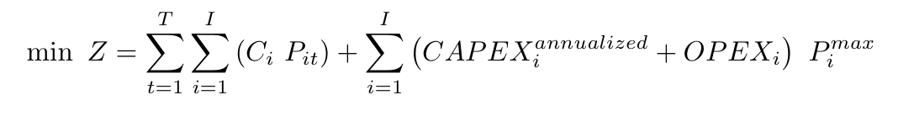
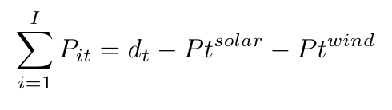
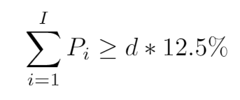
Mathematical Model
Objective function
Demand Satisfaction
Goal limit

Slide 8
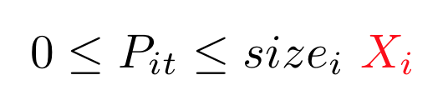
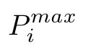
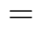
Capacity units
Capacity production in unity of a fixed quantity: new variable X_{i}
Power generation limits

Slide 9
Extensions
Electric vehicles
- From conventional cars to EV
- Adds flexibility in electricity demand
- Effects of demand flexibility
Hydrogen
- Electrolysis plant - storage
- Fuel – fuel cell or gas turbines
- Flexible, lots of losses

Slide 10
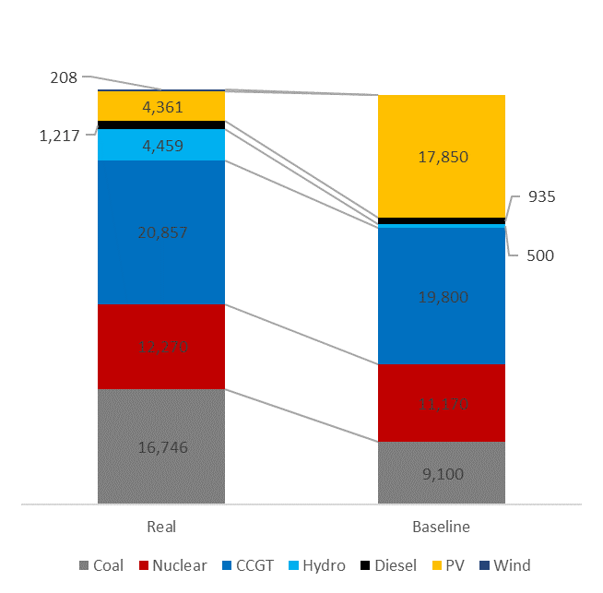
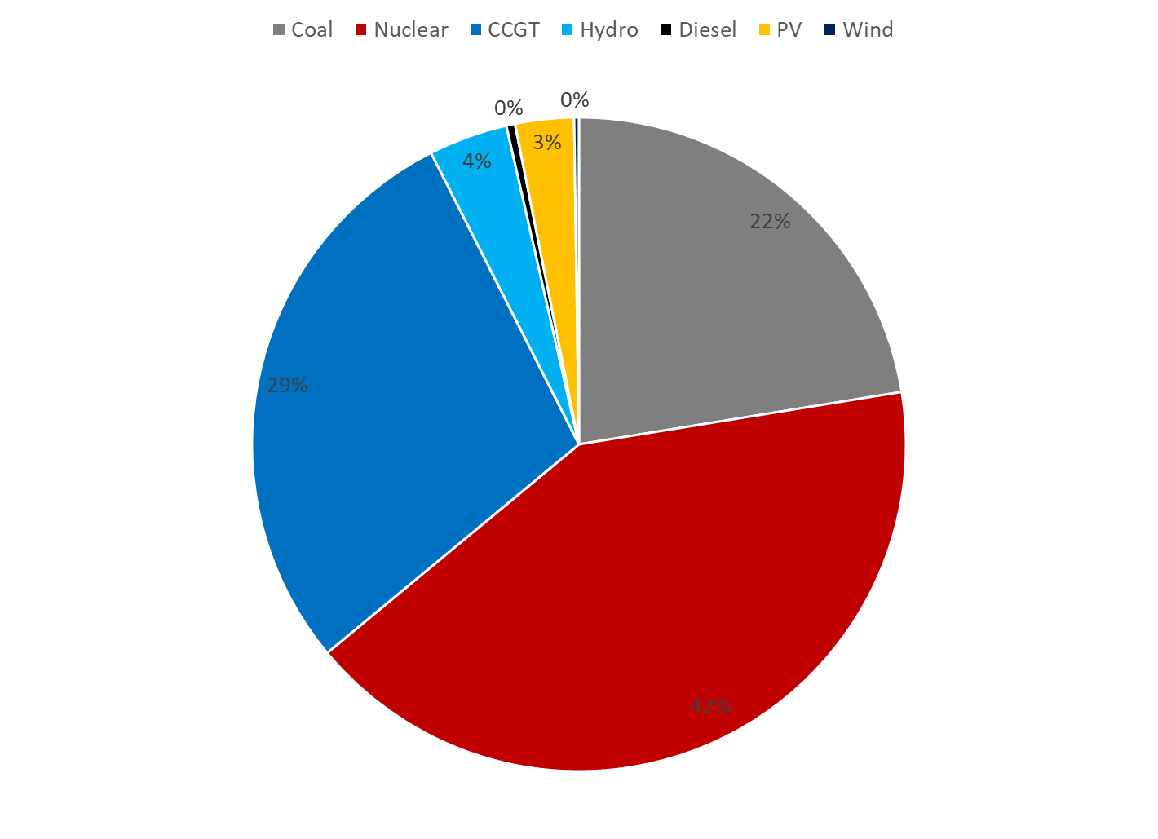
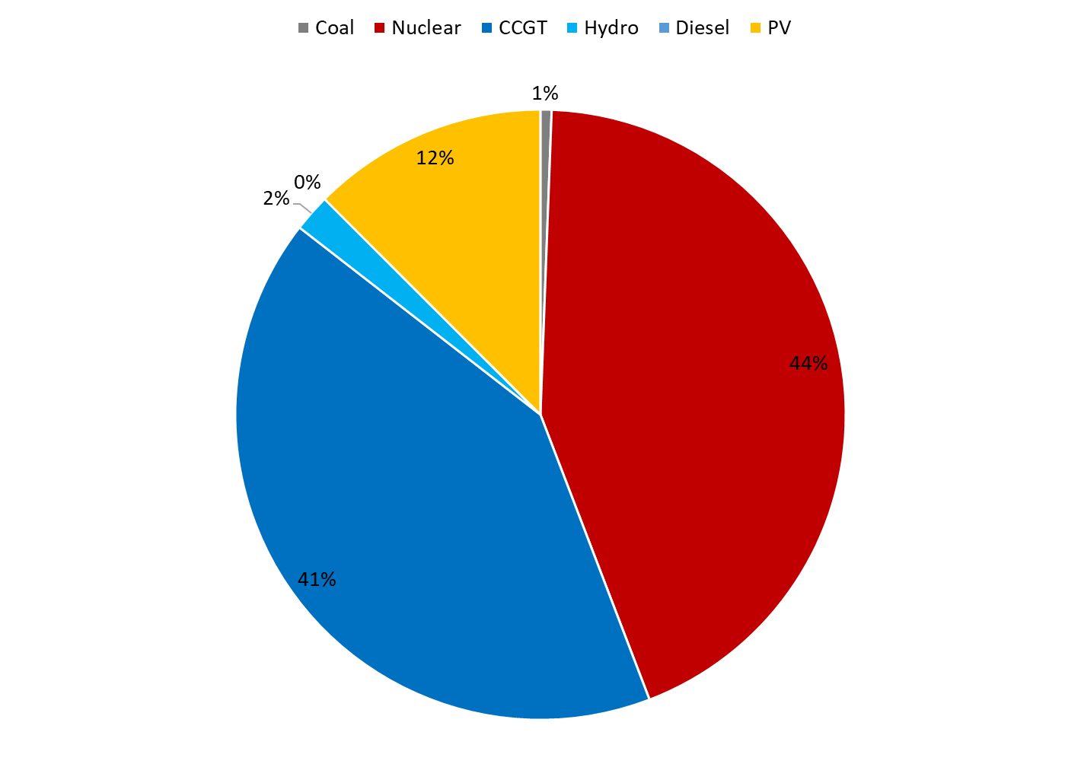
Results
Installed Capacity (MW)
Real Generation
Baseline Generation

Slide 11
Sensitivity Analysis
- Coal Capacity
- Fuel and Emission cost
- Subsidies

Slide 12

Thank you for your listening.
Questions?

